Slide 1
Simple Measurement Unit
w1
w2
W3
wi
Look Scary?
SumProduct
For Implicit Normalization
For Explicit Normalization
Relax! Analogies help

Slide 2
Analogy: Marking System
.1
.2
.5
.2
Assignment
Case Study
Test
Quiz

Slide 3
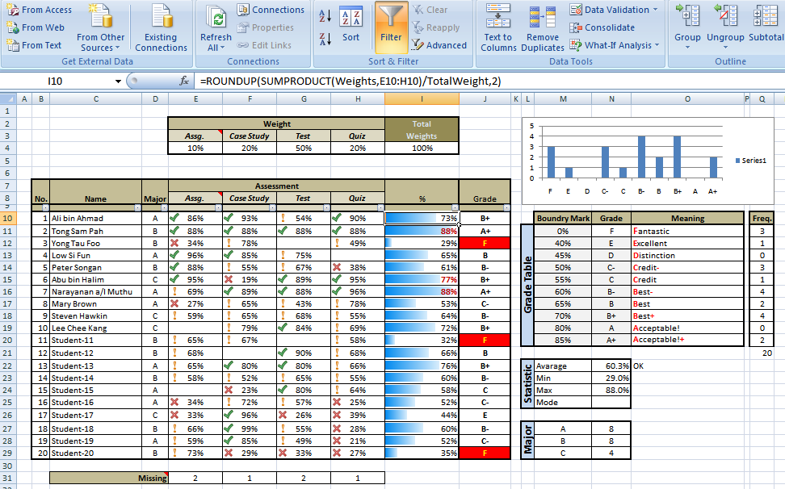
Marking System

Slide 4
Implicit Normalization
The total weight need not be 100%. The formula will ensure the output will fall in between 0..100%. This implied if the output becomes the input, it will be in between 0..100%.
It is done implicitly
New sub measurement can be added or existing sub measurement can be remove without affecting other sub assessments.
Example: The lecturer missed one of the assessment because of some reason. Or sometime additional assessment is given as well.

Slide 5
Explicit Normalization
Under some abnormal circumstances, special normalization is needed.
This need to be done explicitly by the authorized parties which justifications.
Example: The lecturer expectation is too high. The faculty need to normalized the student result for the subject by bring up all the student marks.

Slide 6
The Measurement System
The System can grow.
All the inputs & outputs must be 0..100%

Slide 7
Example: CGPA System
Co-Curriculum
TMX2014
Internship
2nd Year
Result
CGPA
TMT2034

Slide 8
Example: CGPA System
0.1
0.3
0.2
0.3
60%
70%
0.3
0.4
0.5
0.1
0.2
0.1
0.3
0.4
Co-Curriculum
80%
80%
80%
TMX2014
Internship
90%
0.2
0.3
0.3
0.4
80%
90%
???
2nd Year
Result
80%
CGPA
40%
75%
TMT2034
90%
90%

